Slide 1
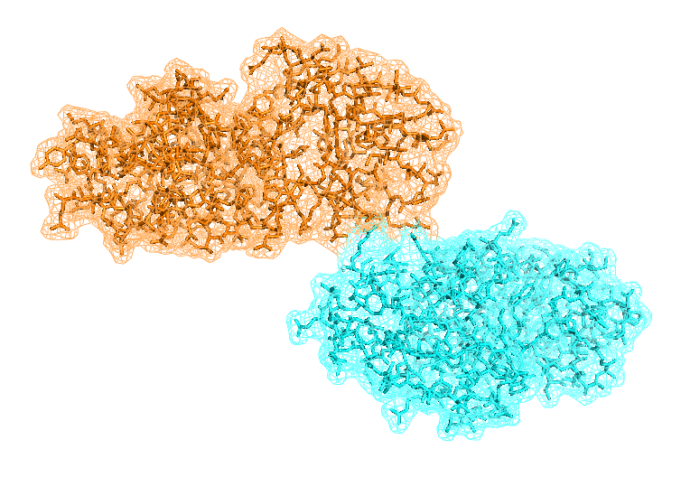


Scoring Group 1: Paula’s angels
P. Milan Rodriguez, F. Gravey,
G. Delevoye, I. Abdelhamid, M. Borry

Slide 2
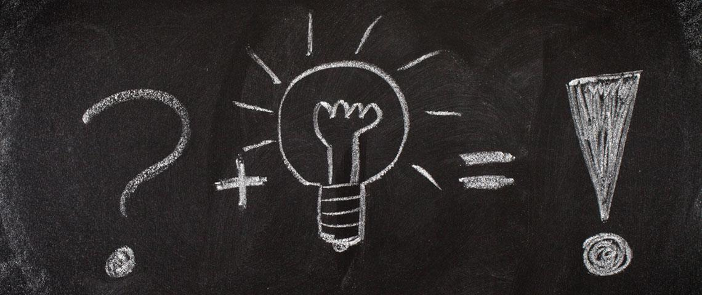
Philosophy
General scoring function
1° - One filter to clear up the list of pdb using Fast Fourier Transform
2° - Selected pdb are sorted by different scores:
Knowledge based
Electrostatic and Van der WaAls interactions
weight of each evaluation:
Refine using tons of native structures and decoys
Machine learning approaches
Scoring Group 1: Paula’s angels

Slide 3

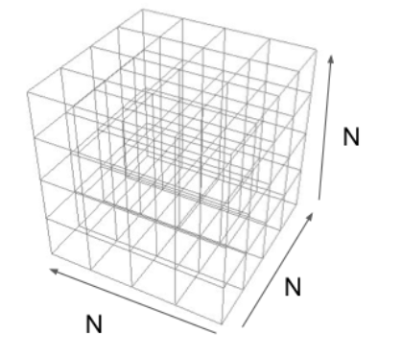
filter
Calcul of residue depth using ‘ResidueDepth function’ a MSMS library from MGLTools
surface residues are placed in a grid for both
“receptor” and “ligand” according to their
coordinates
Remove “wrong pdb” with steric conflicts
Allows to avoid to score some “unrealistic” docking
→ Already coded !
Scoring Group 1: Paula’s angels

Slide 4
Knowledged based scoring
Scoring Group 1: Paula’s angels

Slide 5
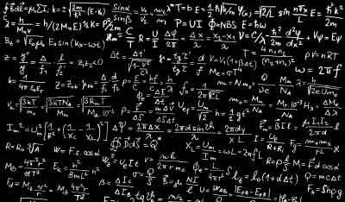

Electrostatic and Van der WaAls interactions
Calculation distance between all residues in surface of the two proteins
determination of the contact interface according to a maximal distance between two residues belonging to different proteins
calculation of Electrostatic and Van der WaAls interactions considering the C𝜷 for all residues except for glycine C𝜶
“Home made” calculations
Sorting each pdb regarding to the liaison free energy
In progress: Evaluation of adding more energy terms such as entropy, torsion, … using FoldX software
(possibly others too !)
Scoring Group 1: Paula’s angels

Slide 6
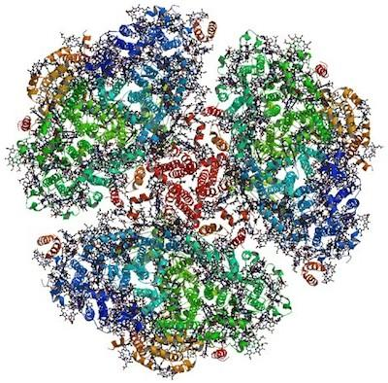
Conclusion
General scoring function
Two steps functionality : Filter then scoring
Scoring based on energy and knowledge based approach
Work in progress :
wrap code
Evaluation of our results
adding others parameters ?
MAchine-learning
Scoring Group 1: Paula’s angels

